Slide 1
ITB/ITN 716
Advanced Web Application Development

Slide 2
Teaching Staff
Unit Coordinator:
Dr Wayne Kelly
  Email: w.kelly@qut.edu.au
  Phone: 3138 9336
  Office: Level 4, 126 Margaret Street.
  Consultation hours: by appointment (within 48 hours)
Tutors
Darryl Cain
d2.cain@student.qut.edu.au
Kenneth Wang
ken.wang@student.qut.edu.au

Slide 3
LEX: The Learning Experience Survey
Make a difference to Learning at QUT
This semester, a new online survey will give all students at QUT the opportunity to contribute to the quality of teaching and learning.
Comment on the things that are important to you
LEX invites you to comment on the things that are important to you - lectures, tutorials and practicals, teaching staff, assessment design, unit resources and learning feedback.
Your Feedback is Confidential
Your teachers and faculty staff receive no student names or student identifying information with their survey results. LEX survey results are strictly for quality review purposes and students' comments are not made available to teaching and faculty staff until after unit results are released.
Lookout for LEX: Opening online in Week 10

Slide 4
Unit Feedback from Last Semester
Students’ Top Comments
Use new version of Visual Studio
Tutor availability
Unreasonable marking criteria
Too much basics, not enough advanced material
Tried to cover too much
This semester:
Using Visual Studio 2005
Tutors will spend less time checking homework
Refined marking criteria for assignment
Less basics, more advanced material
The Teaching Team for this unit
appreciates your Feedback

Slide 5
Administration
Prerequisite:
  ITB007 or ITN007 or equivalent
    simple web development, simple programming, simple database design
Contact Hours per week:
  2 hour Lecture
  1 hour lab session (commencing in week 2)
Textbooks:
  .NET e-Business Architecture by David Burgett, Matthew Baute, John Picket and Eric Brown, SAMS 2002.
References:
  - See lecture notes for lists of online references.
Assessment:
  Homework exercises (pass/fail, marked in tutorials) 10 x 1%
  ASP.NET Programming Assignment (groups of 1, 2 or 3) 40%
  Final Exam 50%

Slide 6
Study Hours
A 12 credit point unit implies that an average student will need to spend an average of 12 hours per week to pass this unit.
Weaker students or students wishing to do better than simply pass may need to spend more hours per week.
As a rough guide, I recommend that you allocate your time approximately as follows:
  Attending Lectures: 13 x 2 hours = 26 hours
  Attending practicals: 12 x 1 hour = 12 hours
  Completing homework exercises 10 x 1 hour = 10 hours
  Weekly pre-reading/reviewing lecture notes 13 x 1.5 hours = 19.5 hours
  Textbook and other readings 13 x 1.5 hours = 19.5 hours
  Assignment 8 x 8 hours = 64 hours
  Start revising for final exam 1 x 5 hours = 5 hours
  ------------------ ---------------
  13 x 12 hours = 156 hours
If you find these tasks taking considerably more time than this, please notify the unit coordinator.

Slide 7
Textbook Readings
Week 1: Chapter 1 “.NET – The Big Picture”
Week 2: Chapter 2 “gasTIX: A Sample .NET e-Business”
Week 3: Chapter 4 “Tools of the Trade”
Week 4: Chapters 5 “Implementing .NET Presentation Services”
Week 5: Chapter 10 “gasTIX Event Searching”
Week 6: Chapters 3 “Enabling Inter-Application Communication”
Week 7: Chapter 6 “Implementing .NET Business Services”
Week 8: Chapter 7 “Implementing .NET Data Services”
Week 9: Chapter 8 “Handling Security”
Week 10: Chapter 11 “Purchasing a Ticket”
Week 11: Chapter 12 “Fulfilment”
Week 12: Chapter 16 “Deploying the Application”

Slide 8
What’s this Unit About?
Software architecture:
  N-tier - architecture for web based systems.
Technology:
  Learn about technologies used to create web based application
    Some ancient, some bleeding edge.
    Some open, some proprietary.
    Some cross platform, some platform specific.
  Learn to critically analyse technologies
    Compare and contrast
    Plan for and predict the future
Overcoming real-world challenges
  Diagnosis, Self directed research, Perseverance

Slide 9
Weekly Lecture Schedule
28/02/07 - Introduction to web based systems and C# Wayne Kelly
07/03/07 - Client-side processing Wayne Kelly
14/03/07 - Server-side processing Wayne Kelly
21/03/07 - Introduction to the .NET platform Wayne Kelly
28/03/07 – ASP.NET and the Presentation Tier Wayne Kelly
04/04/07 – The Middle Tier - pulling it all together Wayne Kelly
11/04/07 – Mid-semester break
18/04/07 – ADO.NET and the Data Tier Wayne Kelly
25/04/07 – Anzac Day
02/05/07 – Web Application Security Wayne Kelly
09/05/07 – Web Services Wayne Kelly
16/05/07 – Other Development Options – J2EE, Rails, LAMP Wayne Kelly
23/05/07 – AJAX Wayne Kelly
30/05/07 - Real World Issues Guest Lecturer
06/06/07 – New Developments and Review Wayne Kelly

Slide 10
Client-Server Applications
Server Machine
Relational Database
Thin
Server
Data
+ Business Logic
Ethernet
Local Area Network
Client Machine
Client Application
Client Machine
Client Application
Client Machine
Client Application
Thick
Clients
Database Access
Database Access
Database Access
Business Logic
Business Logic
Business Logic
UI Logic
UI Logic
UI Logic

Slide 11
Client-Server Applications
Advantages:
  Access to centralized data.
  Rich GUI on the client machines
  Client-side validation and processing possible.
  Some central enforcement of business rules
Disadvantages:
  Difficult to deploy and upgrade client applications.
  Distributed enforcement of business rules.
  Requires homogeneous client platform.
  Business rules implemented in SQL.
  Limited to local area networks.

Slide 12
Then along came ...
The Internet:
A Network of Networks
(1969)

Slide 13
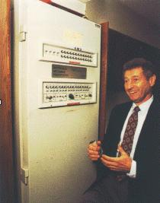
A Brief History of the Internet
1957 Russians launch Sputnik
    Eisenhower creates Advanced Research Projects Agency (ARPA)
1960 First commercial computers
    Point to point communication using circuit-switched telephone lines.
1962 Packet-switching networks proposed
    MIT PhD student Leonard Kleinrock
1969 ARPA creates first WAN using Packet switching (ARPANet)
    4 Nodes (UCLA, Stanford, UC Santa Barbara, Univ of Utah)
1972 First public demonstration of ARPANet
    40 Nodes, supports email and telnet
1973 International nodes join ARPANet (England and Norway)
    Ethernet for LANs, Gateways and FTP developed
1975 ACSNet created in Australia (ftp, email & news)
    dialup modem-based network with store-and-forward
1982 ARPANet moves from NCP to TCP/IP protocol suite
    The term “Internet” introduced
1984 Domain Name Servers (DNS) developed
    1000 Nodes, 131.181.111.1 becomes www.fit.qut.edu.au

Slide 14
Internet Client-Server Applications
Server Machine
Relational Database
Data
+ Business Logic
Internet
TCP/IP
Client Machine
Client Application
Client Machine
Client Application
Client Machine
Client Application
Database Access
Database Access
Database Access
Business Logic
Business Logic
Business Logic
UI Logic
UI Logic
UI Logic

Slide 15
3-Tier/N-Tier Architecture
Data Server
Relational Database
Data Tier
Data
+ Business Logic
Application Server
Middle Tier
Database Access
Business Logic
Internet
TCP/IP
Client Machine
Client Application
Client Machine
Client Application
Client Machine
Client Application
Presentation Tier
Business Logic
Business Logic
Business Logic
UI Logic
UI Logic
UI Logic
(Thinner clients)

Slide 16
3-Tier/N-Tier Architecture
Advantages:
  Separates UI from business logic.
  Central enforcement of business logic.
  Easier to update business logic.
Disadvantages:
  Difficult for TCP traffic to penetrate Firewalls.
  Still difficult to deploy and update client applications.

Slide 17
Then along came ...
The World Wide Web
(1990)

Slide 18

A Brief History of the Web
1960 Harvard PhD student Ted Nelson invents computer-based Hypertext
1985 Standard Generalized Markup Language (SGML)
1990 World-Wide Web (WWW) project
  Created by European Organization for Nuclear Research (CERN)
  HTML, URL's and HTTP
1993 NCSA releases Mosaic (first graphical web browser)
Common Gateway Interface (CGI) - first support for web-based applications
1994 Mosaic commercialized by Netscape
1995 HTML Forms standardized
Apache web server 1.0 – based on popular NCSA web server
Sun announces “Java to be incorporated into Netscape”
1996 Microsoft announces that it will “embrace and extend” the Internet
  Internet Information Server 1.0
  Internet Explorer 1.0
  Active Server Pages (ASP) 1.0
1997 Sun’s Java Servlets
1999 Sun’s Java Server Pages (JSP)
2000 Sun’s Java 2 Platform Enterprise Edition (J2EE)
2001 Microsoft’s ASP.NET

Slide 19
Web-based Applications
Data Server
Relational Database
Data Tier
Data
+ Business Logic
Application Server
Database Access
Business Logic
Middle Tier
Web Server
Business Logic
Presentation Tier
UI Logic
Internet
HTTP
Client Machine
Web Browser
Client Machine
Web Browser
Client Machine
Web Browser
Web Page
Web Page
Web Page
Business Logic
Business Logic
Business Logic
UI Logic
UI Logic
UI Logic

Slide 20
Web-based Applications
Advantages:
  Much easier to deploy and upgrade client software.
  Allows heterogeneous client platforms
  HTTP traffic more likely to penetrate firewalls.
Disadvantages:
  Browser hosted GUI is not as rich as a thick client (limited by HTML).
  Any client-side processing is interpreted script-code (not as expressive and efficient as compiled code).

Slide 21
Beyond N-tier Systems: Application Integration
Large organizations need to maintain and use many different software systems.
  Eg: Invoice processing, Inventory control, Payroll and Online sales.
Some of these might be web-based systems, others not.
Ideally, these systems need to be integrated, i.e. they at least need to be able to communicate with one another.
This is arguably the biggest challenge facing the IT industry.
  Failure to integrate an organizations computer systems can severely hamper its ability to do business.
  But such integration is not easy, and is currently consuming much of the resources of many organization’s IT sections.

Slide 22
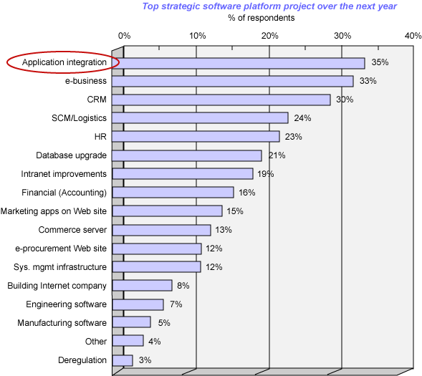
http://www-106.ibm.com/developerworks/webservices/library/ws-migratesoa

Slide 23
Application Integration using Web Technologies
Web technologies are being used not just to deliver application functionality to end users, but also to integrate business applications with one another.
Key idea is to loosely couple systems using platform and language independent open standards such as XML and HTTP.

Slide 24
Web Services
Web servers directly expose functionality rather than a user interface.
  allows the facilities provided at a remote web site to be accessed programmatically.
Similar to remote procedure calls, but encoded using XML and transported using HTTP
  language and platform independent.
  Broad vendor support for web service standards.
Easy to create distributed applications from components created and deployed remotely by other organisations.
  the basis for business to business (B2B) systems.

Slide 25
Unit Summary
 | Client-side Content (Week 2) | Web Browser | Web Server | Server-side UI (Week 3) | Business Logic (Week 3) | Integration | Data Access | Databases (Week 7)
Microsoft .NET (Week 4) | VB Script JScript | IE | IIS | ISAPI ASP ASP.NET (Week 5) | COM+ .NET (Week 6) | MSMQ Remoting | ODBC ADO ADO.NET (Week 7) | Access SQL Server
Sun Java Netscape | JavaScript | Netscape |  | Servlets JSP | EJB J2EE | Java RMI | JDBC
W3C Other | HTML ECMAScript | Opera | Apache | CGI |  | SOAP Web Services (Week 9) |  | Oracle DB2

Slide 26
Developing Web-based Applications
-Software Engineering
Like all major software engineering projects:
  Project planning, management and quality assurance
  Need to work effectively in teams
  Iterative and Incremental software lifecycle
    Analysis, Design, Implementation, Testing and Deployment
  High-quality coding practices:
    Thorough documentation
    Object and component oriented design and programming
      Respecting encapsulation and abstraction
    Clear and elegant code
    Separation of user interface from application logic

Slide 27
Why is Software Development for the Web more difficult?
New technologies to learn and decide between:
  CGI, ASP, JSP, HTML forms, JavaScript, XML, .NET, J2EE, WSDL
Client-Server architecture:
  When and where does processing occur?
  How do the pieces talk and work together?
Heterogeneous client platforms and browsers
  Internet Explorer, Netscape, PDA, WAP
Network communication
  Unreliable, Insecure, High latency
Deployment and Performance
  Can’t be sure exactly how many concurrent users to expect.
    Performance should degrade gracefully as load increases.
    Need to be able to scale performance by adding additional servers.
  Needs to be available 24 hours a day, 7 days a week.
    Elegant fail over to backup servers

Slide 28
Microsoft’s new .NET platform
.NET is a virtual execution environment.
Similar in spirit to the Java Virtual Machine, but:
  not platform independent and
  not language specific.
New Microsoft languages C# and Visual Basic.NET
  but also supports third party languages
  (eg COBOL.NET, Gardens Point Component Pascal, Ruby.NET)
Supported by Visual Studio IDE
  Usable by all languages
New component model
  Replaces COM
Common class library
  Accessible from all languages
  including a new library for creating GUI applications
  ASP.NET is one such class library …

Slide 29
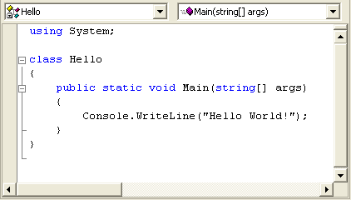
C# Example

Slide 30
C# Language Features
Java like:
  Strongly typed language.
  Single implementation inheritance, multiple interface inheritance.
  Uses java style references.
  Methods are implemented inside the class definition (no header files).
C++ like:
  User defined Value types
  Pointers
Visual Basic like:
  Simple model for creating and accessing components.
  Supports component properties and events
New features:
  Delegates
  Indexers
  new and override modifiers
  foreach statement for iteration through any collection

Slide 31
C# and VB.NET Readings
MSDN Library (http://msdn2.microsoft.com/library)
- Developer Tools and Languages
- Visual Studio .NET
- Visual Basic and Visual C#
- Reference
- Visual C# Language
- C# Language Tour
- C# Language Specification
- C# Programmer’s Reference
- C# Tutorials
- Visual Basic Language
- …

Slide 32
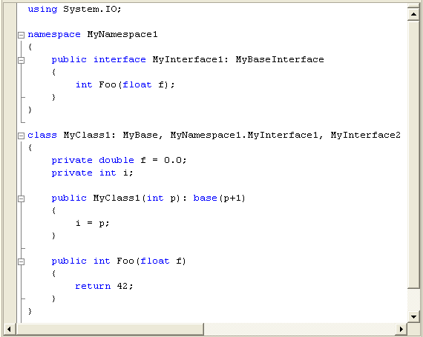
C# Namespaces, Classes and Interfaces

Slide 33
Value vs. Reference Types
C# has reference types like Java:
  class Point
  {
  private int x, y;
  }
  ...
  Point p = new Point();
  p.x = 15;
  Point q = p;
as well as value types like C++:
  struct Size
  {
  private int w, h;
  }
  ...
  Size s, t
  s = t
  s.w = 13;
All of the built in types are value types:
  enum, byte, char, short, int, long, float, double, decimal, bool, ...
x:
15
p:
y:
0
q:
s:
w:
t:
w:
13
0
h:
0
h:
0

Slide 34
C# Arrays
Single-Dimensional Arrays:
  int[] myArray = new int[5];
Array Initialization:
  string[] weekDays = new string[] {"Sun","Sat","Mon","Tue","Wed","Thu","Fri"};
Multidimensional Arrays:
  int[,] myArray = new int[4,3];
  myArray[2,1] = 25;
Jagged Arrays:
  int[][] myJaggedArray = new int[3][];
  myJaggedArray[0] = new int[5];
  myJaggedArray[1] = new int[4];
  myJaggedArray[2] = new int[2];
  myArray[2][1] = 25;

Slide 35
C# Foreach statement
For iterating through:
  arrays
  standard collection classes such as:
    Hashtable, Queue, Stack or SortedList.
  user defined collection classes.
For example:
foreach (Point p in Cities)
{
e.Graphics.FillEllipse(Brushes.Red, p.X-1, p.Y-1, 2, 2);
}
Warning:
  Should not be used to change the contents of the collection.

Slide 36
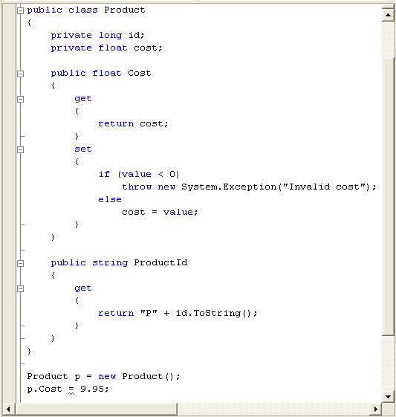
C# Properties

Slide 37
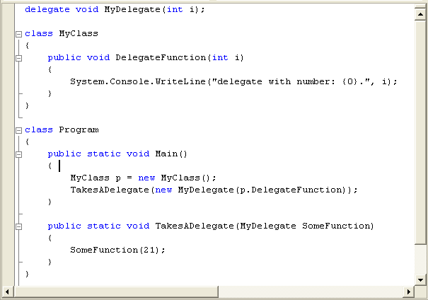
C# Delegates
Object-oriented function pointers:

Slide 38
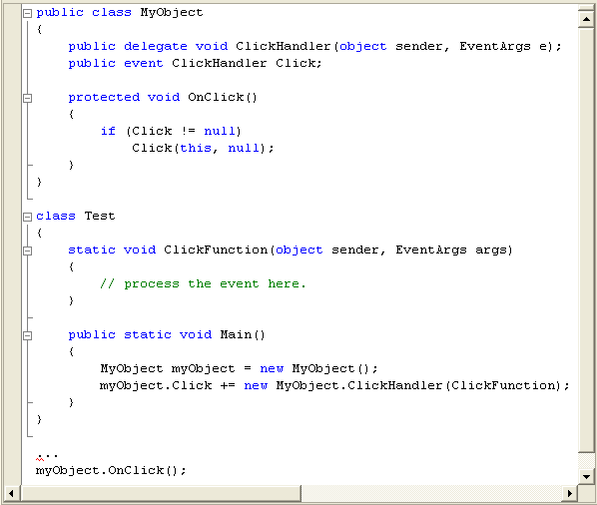
C# Events

Slide 39
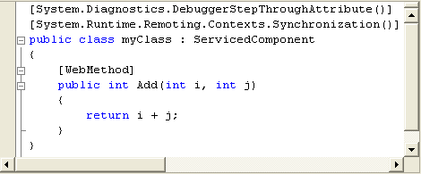
C# Attributes
C# provides a mechanism for defining declarative tags, called attributes, which you can place on certain entities in your source code to specify additional information.
Attributes can affect runtime semantics or be used by tools.
You can use predefined (system) attributes or you can define your own custom attributes.

Slide 40
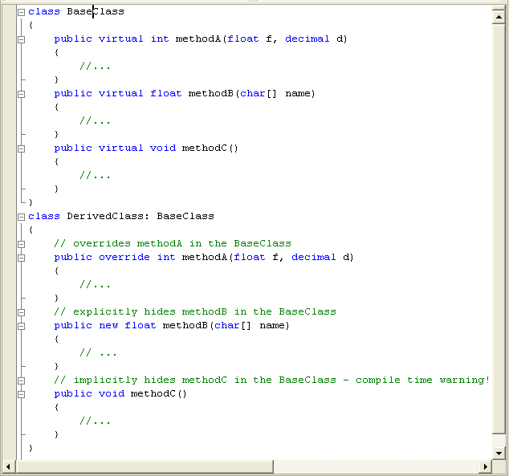
C# Virtual, New and Override

Slide 41
C# I/O
To Standard Output:
  System.Console.Write("hello");
  System.Console.WriteLine();
  System.Console.WriteLine("{0} x {1} = {2}", x, y, x*y);
From Standard Input:
  char c = System.Console.Read();
  string s = System.Console.ReadLine();
To/From Text Files:
  if (System.IO.File.Exists("Input.txt"))
  {
  StreamReader sr = System.IO.File.OpenText("Input.txt");
  StreamWriter sw = System.IO.File.CreateText("Output.txt");
  string line;
  while ((line = sr.ReadLine()) != null)
  sw.WriteLine(line);
  sr.Close();
  sw.Close();
  }

Slide 42
C# Strings (derived from System.String)
An instance of String is said to be immutable because its value cannot be modified once it has been created.
Can be initialized from a literal string:
  string s = "New String";
Concatenation using the + operator:
  string s = "Foo" + t;
Convert an object to a string:
  int i = 42;
  string s = i.ToString();
Other String methods include:
  Insert, PadLeft, Remove, Replace, Split, Substring, ToUpper

Slide 43
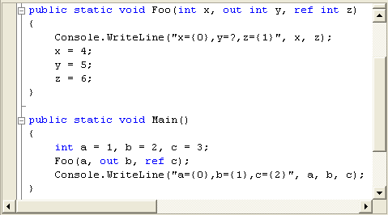
C# In, Out and Ref Parameters
Program Output:
  x=1,y=?,z=3
  a=1,b=5,c=6

Slide 44
C# Accessing Other Components
To access a type defined in a different component all you have to do is include a reference to that component, using:
  the Visual Studio.NET IDE, or
  a command line compiler option
The type is then referred to (via it's qualified name) exactly as if it had been a part of the current component.
To make a type accessible to other components, all you have to do is make it public.

Slide 45
